Slide 1
AUTOMATED CONVEYOR BELT INTERFACED WITH PICK AND PLACE ROBOTIC ARM
SUBMITTED BY: -
Manish Singh Manish Gautam
Braj Kishore Baitha Arekh Sharma

Slide 2

INTRODUCTION
Problem
  The problem is correct selection of material to be processed
Objective
  To automate the selection procedure on a conveyor line

Slide 3
Hardware requirement
Microcontroller
Power supply
D.C. Geared Motor
Reed Switch
Transformer
Diodes & BJT’s
Optocoupler
I.R. sensor

Slide 4
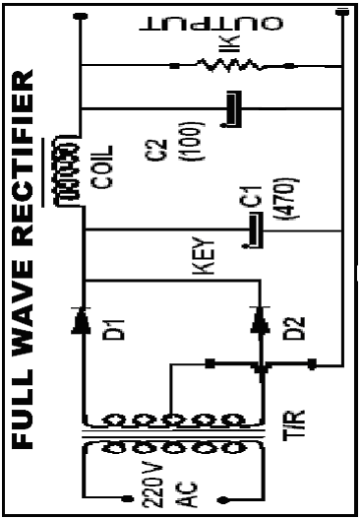
Power supply
Centre tapped transformer
2 PN diodes
1 capacitor
1 LED

Slide 5

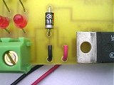
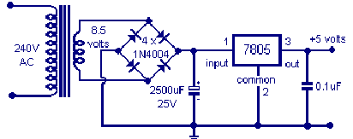
Voltage regulator
Controls the D.C. voltage output
from the full wave rectifiers
(5V,9V or 12V)
Voltage regulators are very robust

Slide 6
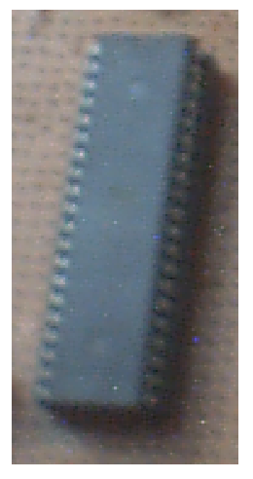
AT89s51 Microcontroller(8051)

Slide 7
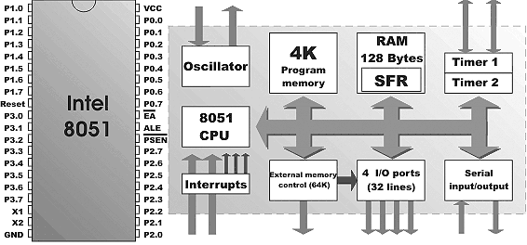
Microcontroller architecture

Slide 8
Programming 8051
Objective of programming
    To control the flow of process
    To capture the signal from the sensors and follow the planned process
Single bit instruction programming being used
e.g. setb p1.1 or clr p1.2

Slide 9
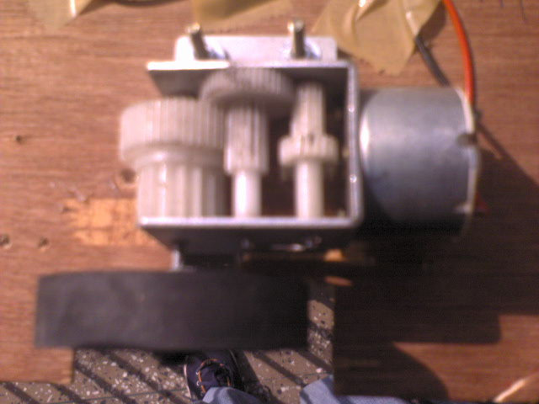
D.C. GEARED MOTOR
Gear train to increase the torque

Slide 10
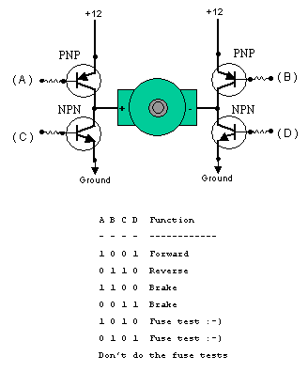
Direction control by
H-Bridge
Binary logic either
10 or 01
changes the
direction of motor

Slide 11
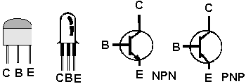
BJT’s
PNP
NPN
Main use of the BJT in the project is for the direction control of the motor
Direction control only to
    Arm motor
    Gripper motor

Slide 12
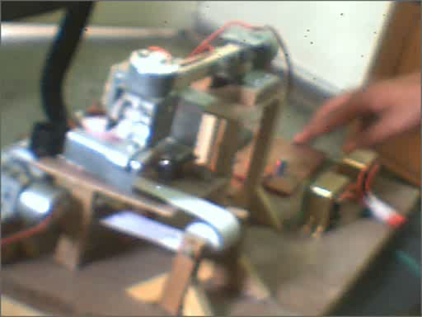
Play movie

Slide 13
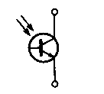
Infra Red
Electromagnetic spectrum wavelength is longer than visible light
Used for detecting the incoming object
A pair of Infrared LED and a photo transistor is used

Slide 14
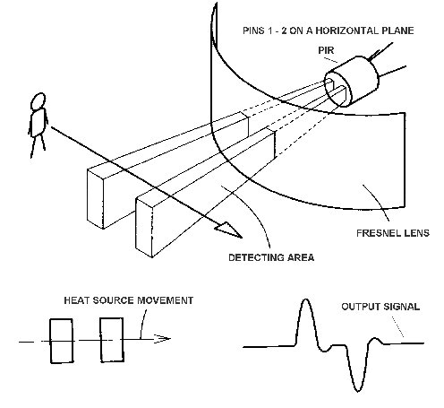
Working of IR sensor

Slide 15
OPTO-COUPLERS
Opto-isolator = optical isolator =
opto-coupler = photo-coupler
device that uses a short optical transmission path to transfer a signal between elements of a circuit
typically a transmitter and a receiver; electrical contact along the path is broken

Slide 16
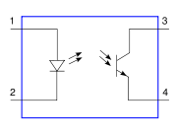
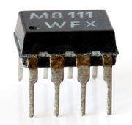
Implementation of opto-coupler
Unlike a transformer, the opto-isolator allows for DC coupling and provides protection from serious overvoltage conditions between circuits

Slide 17

Reed switch
The reed switch is an electrical switch
operated by an applied magnetic field
pair of contacts of ferrous metal
contacts normally open, closing when a magnetic field is present

Slide 18
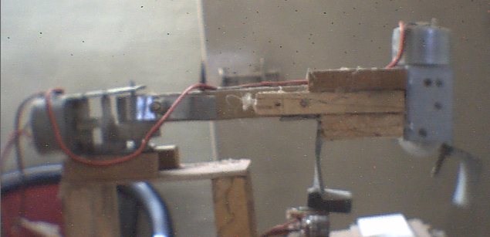
Robotic arm
1 D.O.F. => the arm being operated by a D.C. motor
Gripper being mechanically actuated by the motor

Slide 19
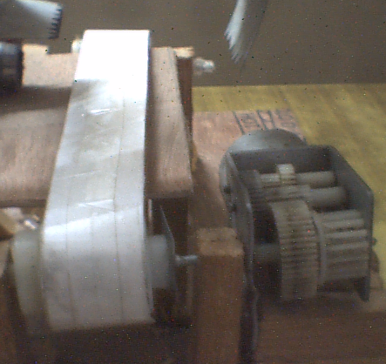
Conveyor belt
two pulleys, with a continuous loop of material
D.C. motor
driven

Slide 20
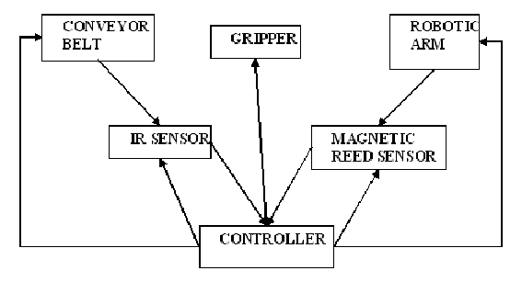
Flow of control

Slide 21
LIMITATIONS
Only one degree of freedom to the robotic arm
Workpiece height limited
Only bright coloured reflective objects can be detected
Gripper not efficient

Slide 22

Further Work
Increasing the degree of freedom
    Will increase the flexibility and workspace
User defined programming
    The position can be dynamically modified
vision system
    The system can understand its surrounding
Intelligent gripper
    Can have the flexibility of a human hand

